Slide 1
On the monotonicity of the expected volume of a random simplex
Luis Rademacher
Computer Science and Engineering
The Ohio State University
TexPoint fonts used in EMF.
Read the TexPoint manual before you delete this box.: AAAAAAAAAAAA
Notes:
Sylvester’s problem
Meckes’s conjectures, Reitzner’s question.
Connection with slicing
Main result.
Similarity with Busemann-Petty.
Connection with slicing.
Dimension-dependent.
Differences: no Fourier here, elementary argument.
Santosh’s question, connection with slicing
Solution to Santosh’s question
Intuition: extreme point near the origin.
Derivative easy to compute and sufficient.
value of derivative
dimension-dependent condition
When does the condition hold? Milman Pajor.
Explicit example.
Solution to Mecke’s strong conjecture
Crofton’s differential equation
… same as Santosh, theorem statements without proof
Open questions:
random polytope
moments
weak conjecture via Crofton’s differential equation

Slide 2
Sylvester’s problem
4 random points: what is the probability that they are in convex position?
: convex hull of n random points in convex body K.
Which convex bodies K are extremal for

Slide 3
Questions by Meckes and Reitzner
M’s weak conjecture: for n=d+1 (random simplex) there exists some c.
M’s strong conjecture: for n=d+1 and c=1
R’s question: for arbitrary n and c=1.

Slide 4
Connection with slicing
Slicing conjecture: every d-dimensional convex body of volume one has a hyperplane section of area >=c for some universal c.
Equivalent: for K a d-dimensional convex body
M’s weak conjecture ⇔ slicing

Slide 5
Main result
About M’s strong conjecture:
True in dimension 1,2
False in dimension >=4
Strong numerical evidence for falsity in dim. 3.

Slide 6
Busemann-Petty
Classical: when c=1, true iff dim<5
∃ c ⇔ slicing
Similarity with our problem:
Dimension-dependent answer, connection with slicing
Difference with our problem:
Ours has “elementary” solution, no Fourier analysis.

Slide 7
Question by Vempala
A(K) = covariance matrix of K
Original question: for c=1.

Slide 8
Question by Vempala
∃ c ⇔ slicing:
⇐: easy from * and bounded isotropic constant
⇒:
Let K,M be two convex bodies. Assumption with * imply L_{K} ≤ c^{1/2} d(K,M) L_{M} : By affine invariance, w.l.o.g. K,M are in position such that K ⊆ M ⊆ d(K,M)K. Implies vol M ≤ d(K,M)^{d} vol K.
Use Klartag’s isomorphic slicing problem:
given K,ε, there exists M s.t. d(K,M)≤ 1+ε and

Slide 9
Question by Vempala
Connection with random simplexes: (μ(K)=centroid of K)
I.e. “second moment” version of Meckes’s question.

Slide 10
Second result
We also solve Vempala’s question for c=1
True in dimension 1,2
False in dimension >=3
Our solution to Vempala’s question inspired our solution to Meckes’s strong conjecture.

Slide 11
Solution to Vempala’s question
Intuition: extreme point near the centroid
E (random simplex using L\K) < E(… using L)
Notes:
“Joke”: in the proof I’ll honor my origins as an engineer and do what engineers do best: differentiate and integrate.

Slide 12
Solution to Vempala’s question
Idea: Monotonicity of K  det A(K) holds for dimension d iff for every K ⊆ L there is a non-increasing “path” of convex bodies from L to K. We will:
define “path”,
compute derivative along path, and
study sign of derivative.

Slide 13
Solution to Vempala’s question
W.l.o.g. K is a polytope (by continuity, if there is a counterexample, then there is one where K is a polytope)
“Path”: “push” hyperplanes parallel to facets of K “in”, one by one.
L
K

Slide 14
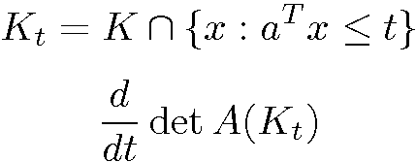
Solution to Vempala’s question
det A(⋅) continuous along path, piecewise continuously differentiable.
Enough to compute derivative with respect intersection with moving halfspace.
Enough to compute derivative in isotropic position (sign of derivative is invariant under affine transformations).

Slide 15
Solution to Vempala’s question
Simple value of derivative in isotropic position:

Slide 16
Solution to Vempala’s question
Derivative implies dimension dependent condition:
Proof:
“if part”: condition implies negative derivative along path.

Slide 17
Proof (cont’d)
“Only if” part:
There is an isotropic convex body L’ with a boundary point x at distance <d^{1/2} from the origin.
By an approximation argument can assume x is extreme point (keeping isotropy and distance condition) of new body L.
Positive derivative as one pushes hyperplane “in” at x a little bit.
If K is “L truncated near x”, det A(K) > det A(L).

Slide 18
When does the condition hold?
Condition: for any isotropic convex body K
Milman-Pajor, Kannan-Lovász-Simonovits: For any isotropic convex body K:
and this is best possible.
I.e., condition fails iff d ≥ 3.

Slide 19
Solution to Meckes’s strong conjecture
Argument parallels case of det A(K):
same path between K and L (push hyperplanes in), same derivative (i.e. with respect to moving hyperplane)
Our derivative is a special case Crofton’s differential equation:
(from Kendall and Moran, “Geometrical Probability”, 1963)
Notes:
“Joke”: weird reference

Slide 20
Derivative

Slide 21
Solution to Meckes’s strong conjecture
Dimension dependent condition (same proof):

Slide 22
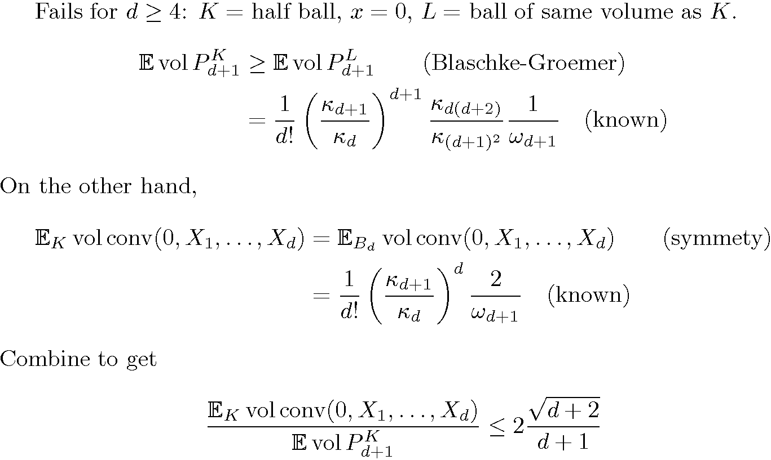
When does the condition hold?

Slide 23
When does the condition hold?
true for d=1, easy (directly, without the condition)

Slide 24
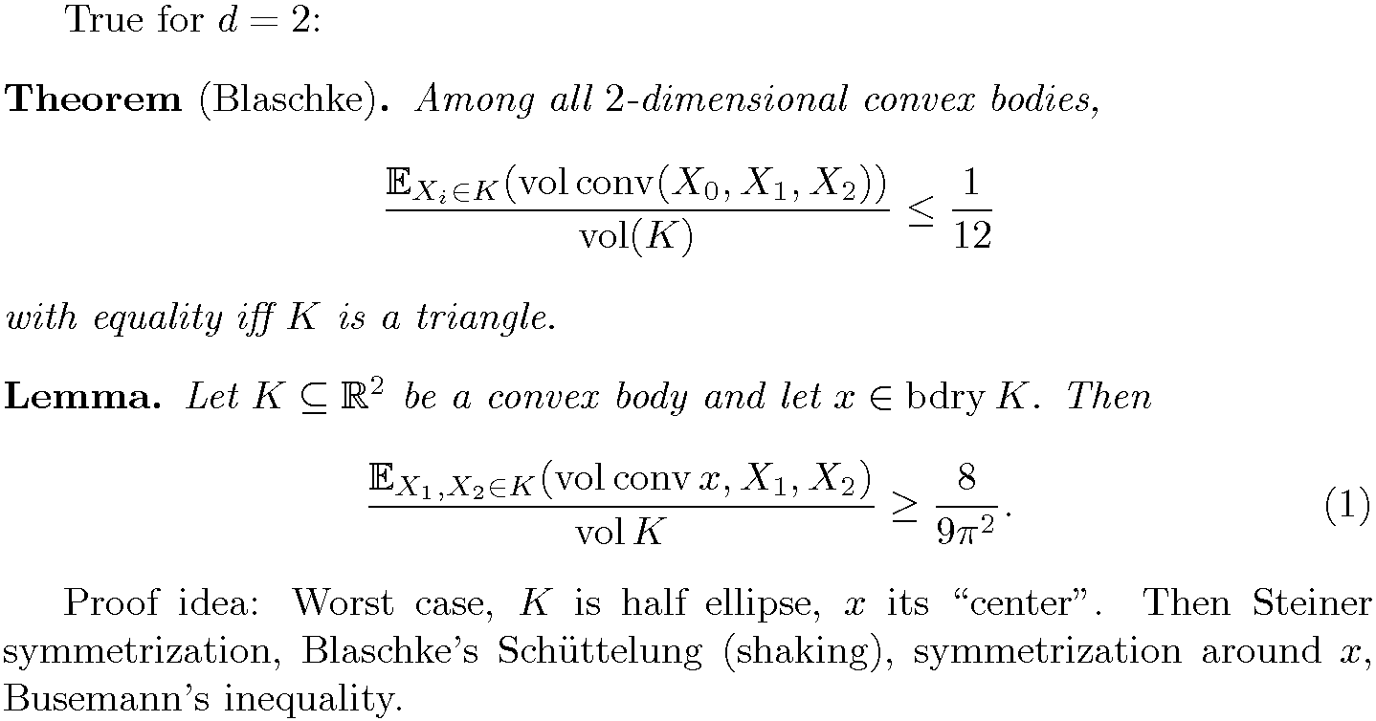
When does the condition hold?
Notes:
Symmetrization ‘till you drop dead…

Slide 25
When does the condition hold?
d=3? The proof doesn’t handle it, but numerical integration strongly suggests “false” (same counterexample).

Slide 26
Open questions
Higher moments?
(Reitzner) What about more than d+1 points?
(technical) 3-D case
Weak conjecture via Crofton’s differential equation?

