Slide 1

All about pass times
Orientation 2020| First Year and Transfer Students| All About Pass Times

Slide 2

What Is a Pass Time?
A Pass Time is a window of time (4 hours) in which you are able to register for courses.
Pass Times are assigned based on how many units you have
A senior will have a better pass time than a junior, etc.
This is because these students have specific classes that they need in order to graduate
AP units DO NOT count toward your total unit count for Pass Time calculations!
Notes:
Insert a map of your country.

Slide 3

What if I miss my Pass Time?
If you miss your pass time window, don’t panic!
You will still have an opportunity to register for courses
If it is the day of registration, you can wait until open hours (Sa-Su, 10am-6pm) or (M-F, 8pm-12am) and register then
Just make sure you don’t miss those too!
If it is a day or more after, you can try to use open hours. If that doesn’t work you may have to wait until your Pass 2 time
Notes:
Insert a picture of one of the geographic features of your country.

Slide 4
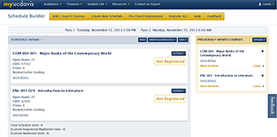
Schedule Builder
Schedule Builder is the system you will use to register for classes
My.ucdavis.edu/schedulebuilder
It can take some getting used to, but it’s not too bad!
You’ll notice a bar at the top that will help you navigate the system:
Add/Search courses is a useful tool that you’ll get to know as you use it.
Notes:
Insert a picture illustrating a season in your country.

Slide 5
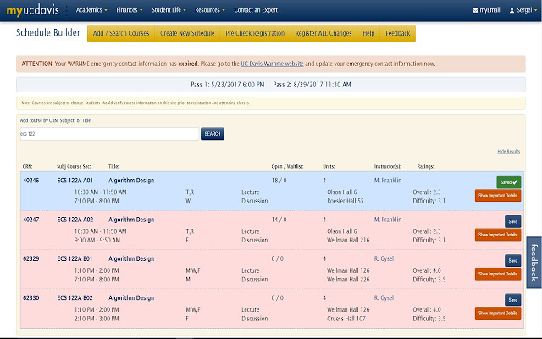
Where to find your pass time
You Pass Time can be found here. Note that this will tell you both your Pass 1 (first opportunity to register) and your Pass 2 (second opportunity to register).
We highly recommend looking up your pass times and putting a reminder in your phone for 30 minutes to an hour before to make sure you don’t miss them.
Be sure to have your schedule set up in advance, as well as backup schedules so you can be sure to get the courses you need!
Notes:
Insert a picture of an animal and or plant found in your country.

Slide 6
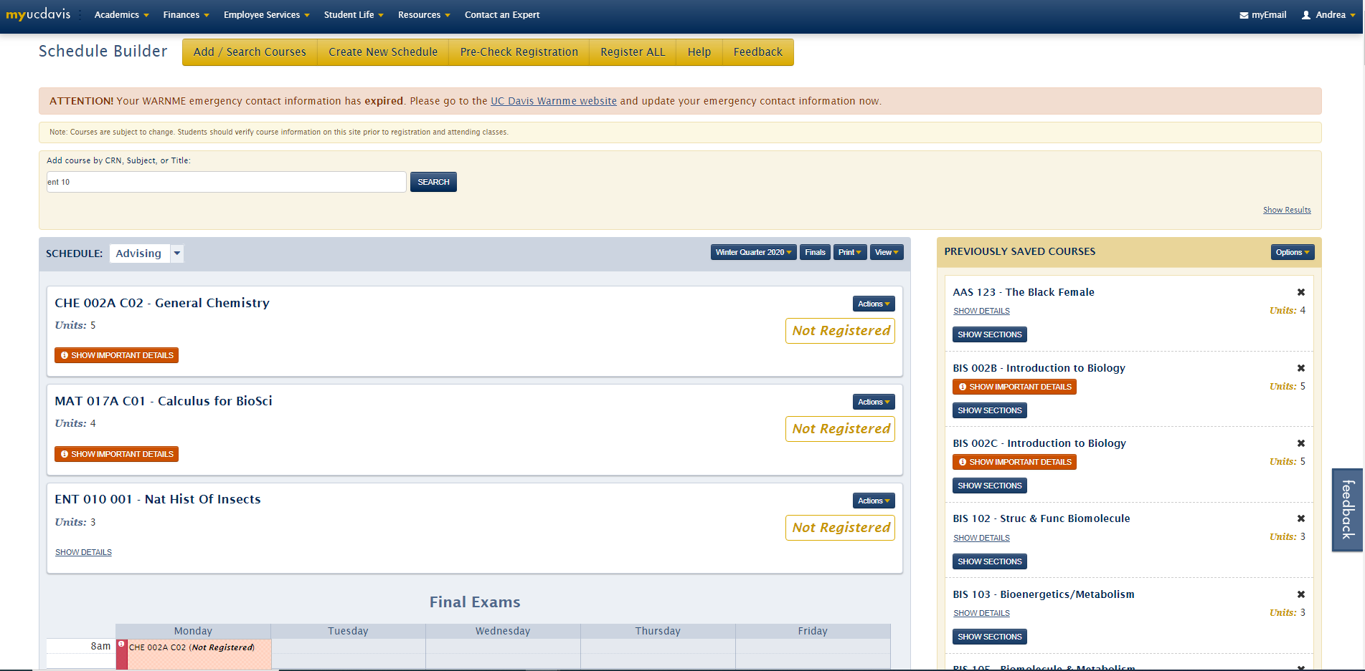
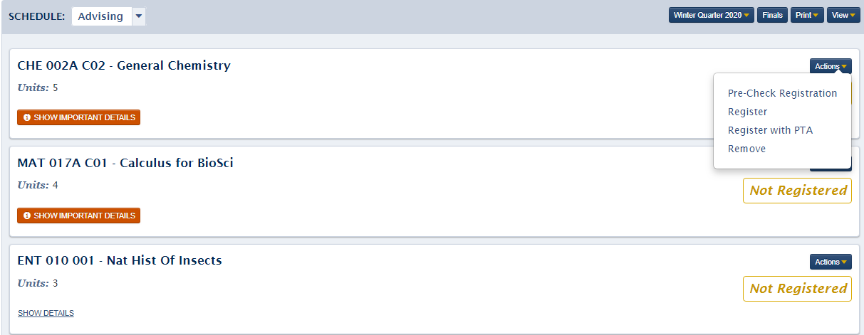
How to register for a class
Once you have the courses you would like to take saved, and it is your pass time, you can go ahead and hit “Register All”
If you need to register for an individual course, you will hit “Actions” and then “Register” instead
Notes:
Add key points in the history of your country to the timeline.

Slide 7
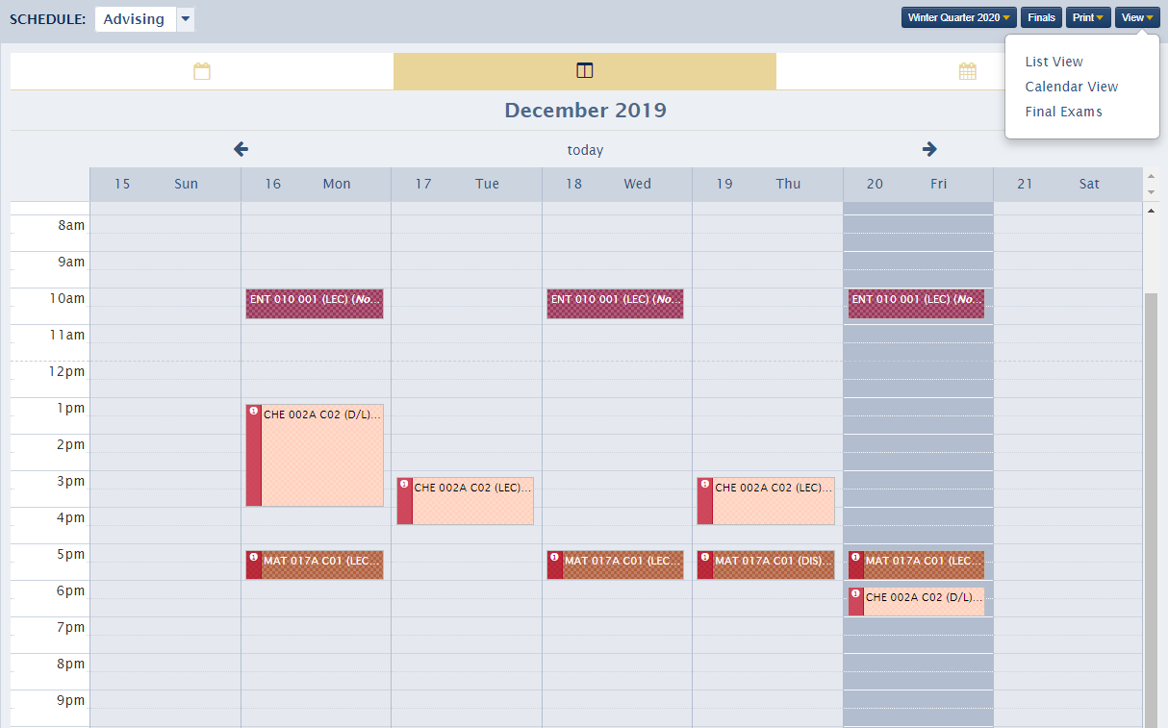
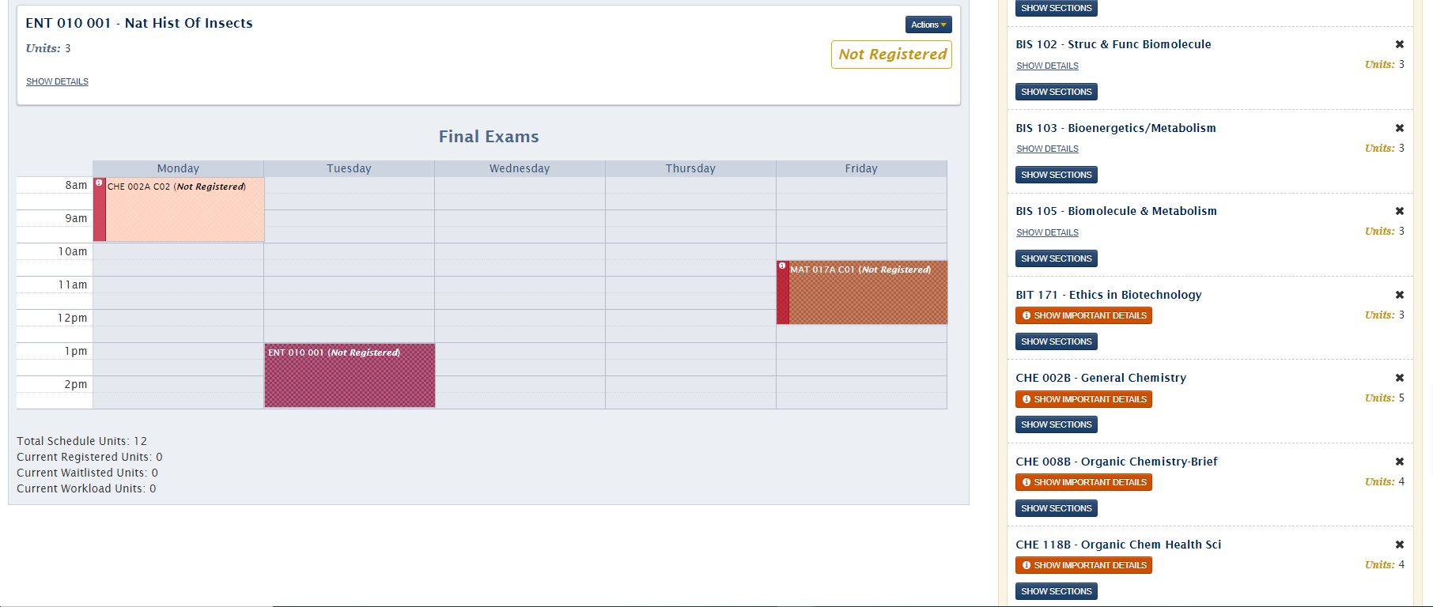
Tips and tricks
1.
A couple of tips from our office (collectively we have used schedule builder for 22 years!!!)
1. Always utilize calendar view! Just click view and then select calendar- it’ll show you the times instead of you having to figure them out!
2. If you scroll all the way down, it’ll show you your final exam schedule. Make sure all your finals aren’t on the same day!
3. If you stay scrolled down, you can see your total schedule units! Make sure you are at 12 or above for full time status!
2.
3.
Notes:
Insert a picture illustrating a custom or tradition here.

Slide 8
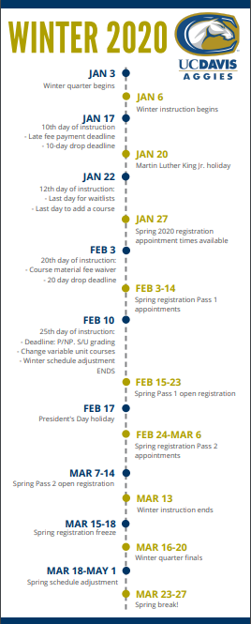
Registration Calendars
Our peer advisors make these incredibly helpful calendar guides.
They include all major academic dates and deadlines, including:
First day of the quarter
First day of instruction
University Holidays
Last day to add/drop courses
Registration and pass time dates
Registration Freeze dates
Final Exam dates
Make sure you utilize them!
They will be sent out via email at the beginning of each quarter
They will also be attached to this module for the coming year!
Notes:
Insert a picture of the head leader of your country.

Slide 9
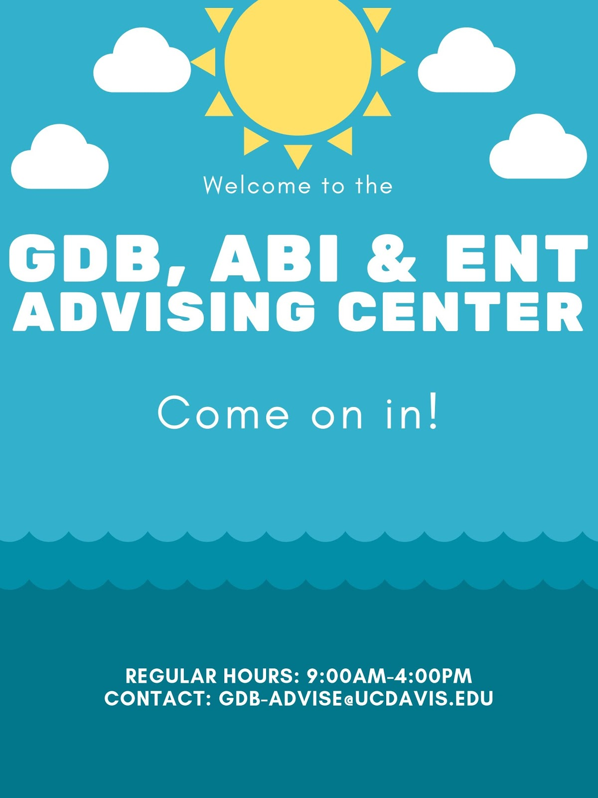
Where to go with scheduling questions
We are available to help with scheduling questions!
Please note that you have several ways to contact us:
Via email (gdb-advise@ucdavis.edu)
In person (150 Hutchison Hall)
Over the phone (530-754-4131 or 530-754-2281)
Make sure you come armed with questions, a good attitude, and a willingness to learn!
Notes:
Insert a picture that illustrates some part of your country’s economy.

Slide 10

When will you register for classes for fall 2020?
After finishing the modules and meeting (either remotely, or in person) with an advisor!
It is important to meet with us so that we can help you make your schedule
We can take into account placement test scores, previous coursework, etc. and get you in the best classes for you!
Instructions for how to meet with us will come later!
Notes:
Insert a picture of one of the points of interest for your country.

